Slide 1


Introduction to OpenStack.net
Don Schenck, OpenStack.net Developer Advocate, Rackspace
October, 2013

Slide 2
Agenda
What is OpenStack?
Using .NET with OpenStack
  Creating a server
  Creating a container
  Uploading a file
  Making the file available publicly
Other SDKs

Slide 3
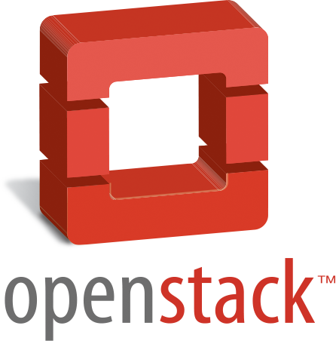
WHAT IS
?
Notes:
Open technology company that’s obesessed with great customers service – what is changing that is we are becoming more a technology company –i.e. software
Our strategy has not changed******
Rackspace grew up delivering open technologies to our customers. We feel so strongly about this that recently we re-branded Rackspace as “the Open Cloud Company”….which really is intended to reinforce the notion of choice
We continue to drive product development that creates a seamless portfolio for our customers
And of course, Fanatical support in all that we do
In 2012 we introduced Fanatical support on the Open Cloud
Home of
Fanatical ---------→ 
Support
Open + Fanatical
Support
We are now the open cloud company

Slide 4
(This is a server. No, really)

Slide 5
HYPERVISOR

Slide 6
HYPERVISOR

Slide 7
HYPERVISOR

Slide 8
HYPERVISOR

Slide 9
What is OpenStack?
It’s an O/S
Many Hypervisors
  XenServer/XCP
  KVM on x86
  QEMU on x86
  LXC via libvirt
  ESXi/VC
  Hyper-V
  Baremetal
  PowerVM
  Docker
You can do “Cloud Things”
Lots of SDKs

Slide 10
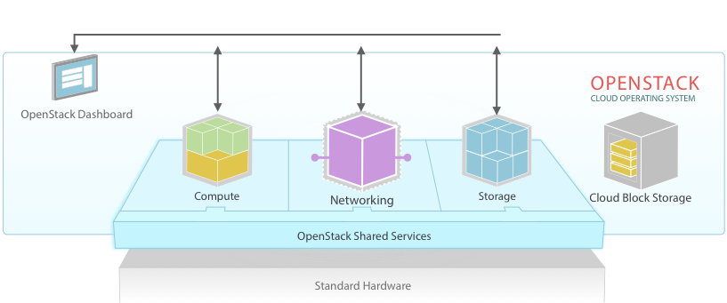
SDKs

Slide 11
How to install the SDK
Use NuGet
Easiest way is to search for “OpenStack sample”
If you wish to use the NuGet package management console:
  Install-Package openstack.net

Slide 12
How to update the SDK
Use NuGet update function
Get-Package –Updates
Update-Package openstack.net

Slide 13
Demo (in C#)
Sample code is available at
https://github.com/rackspace/openstack.net/wiki
https://github.com/rackspace/openstack.net/wiki/Getting-Started-With-The-OpenStack-NET-SDK
the NuGet package
This SDK will support all .NET languages; dozens now, including VB, F#, IronRuby, IronPython, AVR, Boo and many more (yes, even COBOL!)

Slide 14
Referencing the SDK
Add a reference in your project
  Note: The NuGet Package install will do this automagically
Then, in your C# code...
using net.openstack.Core.Domain;
using net.openstack.Core.Providers;
using net.openstack.Providers.Rackspace;

Slide 15
var cloudId = new CloudIdentity(){
Username = “username”,
APIKey = “api_key_goes_here”};
CloudIdentityProvider cip = new CloudIdentityProvider();
cip.Authenticate(cloudId);
Console.WriteLine("Successfully retrieved Token for user: {0}", cloudId.Username);
Console.WriteLine("Press any key to continue...");
Console.ReadLine();
Authentication

Slide 16
var cfp = new CloudFilesProvider(_cloudIdentity);
cfp.CreateContainer(“CPOSC”);
Create a Container

Slide 17
cfp.CreateObjectFromFile(
container: “CPOSC,”
filePath: @”C:\CPOSC\sunbeam.mov”,
objectName: “sunbeam.mov”,
contentType: “video/quicktime”);
Upload a File

Slide 18
cfp.EnableCDNOnContainer(“CPOSC”);
Make the Container a CDN

Slide 19
ContainerCDN cntnr = cfp.GetContainerCDNHeader(
container: containername,
identity: cloudId)
Console.WriteLine("URL-HTTP: {0}", cntnr.CDNUri);
Console.WriteLine("URL-HTTPS: {0}", cntnr.CDNSslUri);
Console.WriteLine("URL-iOS streaming: {0}", cntnr.CDNIosUri);
Console.WriteLine("URL-streaming: {0}", cntnr.CDNStreamingUri);
Get the URLs

Slide 20
string container = “CPOSC”;
string outPath = @ “C:\CPOSC\Downloads\”;
string objName =“sunbeam.mov”;
cfp.GetObjectSaveToFile(container, outPath, objName);
Download the File

Slide 21
cfp.DeleteObject(containerName, objectname);
Delete the Object

Slide 22
cfp.DeleteContainer(containerName);
Delete the Container

Slide 23
Resources
www.openstack.org
openstacknetsdk.org
developer.rackspace.com
github.com/rackspace
rackspacestartups.com
Geekdom.com

Slide 24
QUESTIONS? don.schenck@rackspace.com
Twitter: @DonSchenck

